Slide 1
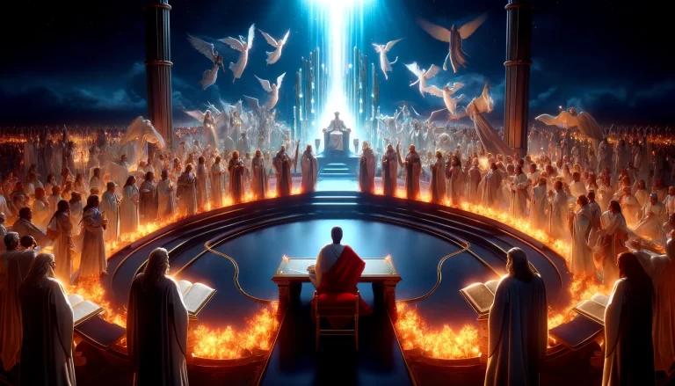

Court of Heaven
Apostle Dan Peters 6-22-25
This Photo by Unknown Author is licensed under CC BY
This Photo by Unknown Author is licensed under CC BY

Slide 2
Petitions; defined by LAW a request or plea in which specific court action is asked for
Psalms 20:5
5 We will rejoice in thy salvation, and in the name of our God we will set up our banners: the LORD fulfil all thy petitions.

Slide 3
1John 5:15
15 And if we know that he hear us, whatsoever we ask, we know that we have the petitions that we desired of him.

Slide 4
Philipians 4:6-7
6 Be careful for nothing; but in every thing by prayer and supplication with thanksgiving let your requests be made known unto God.
7 And the peace of God, which passeth all understanding, shall keep your hearts and minds through Christ Jesus

Slide 5
Supplication is an expression of need, entreaty, humble and earnest prayer in worship, or a petition. The term is used in the King James Version of the Bible, for example in 1 Timothy 1:1 and Zephaniah 2:1. In Roman antiquity, supplication was a religious solemnity observed in consequence of some public calamity or impending danger.

Slide 6
All prayer
1John 5:13-15
13 These things have I written unto you that believe on the name of the Son of God; that ye may know that ye have eternal life, and that ye may believe on the name of the Son of God.
14 And this is the confidence that we have in him, that, if we ask any thing according to his will, he heareth us:
15 And if we know that he hear us, whatsoever we ask, we know that we have the petitions that we desired of him.

Slide 7
Day of trouble
Psalms 86:5-7
5 For thou, Lord, art good, and ready to forgive; and plenteous in mercy unto all them that call upon thee.
6 Give ear, O LORD, unto my prayer; and attend to the voice of my supplications.
7 In the day of my trouble I will call upon thee: for thou wilt answer me.

Slide 8
THRONE OF GRACE
Hebrews 4:14-16
14 Seeing then that we have a great high priest, that is passed into the heavens, Jesus the Son of God, let us hold fast our profession. 15 For we have not an high priest which cannot be touched with the feeling of our infirmities; but was in all points tempted like as we are, yet without sin. 16 Let us therefore come boldly unto the throne of grace, that we may obtain mercy, and find grace to help in time of need.

Slide 9
BOLDNESS TO ENTER
Hebrews 10:19-23
19 Having therefore, brethren, boldness to enter into the holiest by the blood of Jesus, 20 By a new and living way, which he hath consecrated for us, through the veil, that is to say, his flesh; 21 And having an high priest over the house of God; 22 Let us draw near with a true heart in full assurance of faith, having our hearts sprinkled from an evil conscience, and our bodies washed with pure water. 23 Let us hold fast the profession of our faith without wavering; (for he is faithful that promised;)

Slide 10
HOPE
Romans 4:17-22
17 (As it is written, I have made thee a father of many nations,) before him whom he believed, even God, who quickeneth the dead, and calleth those things which be not as though they were. 18 Who against hope believed in hope, that he might become the father of many nations, according to that which was spoken, So shall thy seed be. 19 And being not weak in faith, he considered not his own body now dead, when he was about an hundred years old, neither yet the deadness of Sara's womb: 20 He staggered not at the promise of God through unbelief; but was strong in faith, giving glory to God; 21 And being fully persuaded that, what he had promised, he was able also to perform. 22 And therefore it was imputed to him for righteousness.

Slide 11
THE LAW OF FAITH
Romans 3:27 (HCSB)
²⁷ Where then is boasting? It is excluded. By what kind of law? By one of works? No, on the contrary, by a law of faith.

Slide 12
THE LAW OF THE “ SPIRIT OF LIFE”
Romans 8:-2 (AMP)
² For the law of the Spirit of life [which is] in Christ Jesus [the law of our new being] has freed me from the law of sin and of death.

Slide 13
TILL WE COME INTO THE UNITY OF FAITH
Ephesians 4:1-24 (KJV)
¹ I therefore, the prisoner of the Lord, beseech you that ye walk worthy of the vocation wherewith ye are called, ² With all lowliness and meekness, with longsuffering, forbearing one another in love; ³ Endeavouring to keep the unity of the Spirit in the bond of peace.
⁷ But unto every one of us is given grace according to the measure of the gift of Christ.
¹³ Till we all come in the unity of the faith, and of the knowledge of the Son of God, unto a perfect man, unto the measure of the stature of the fulness of Christ:
NOTE: One verdict from the Courts of Heaven delivers the saints from defeat and places them in dominion…

Slide 14
TILL WE COME INTO THE UNITY OF FAITH
Isaiah 43:25-26
25 I, even I, am he that blotteth out thy transgressions for mine own sake, and will not remember thy sins.
26 Put me in remembrance: let us plead together: declare thou, that thou mayest be justified. (State your case,that you may be acquitted.)

Slide 15
GOD AS JUDGE
Hebrews 12:22-24
22 But ye are come unto mount Sion, and unto the city of the living God, the heavenly Jerusalem, and to an innumerable company of angels, 23 To the general assembly and church of the firstborn, which are written in heaven, and to God the Judge of all, and to the spirits of just men made perfect, 24 And to Jesus the mediator of the new covenant, and to the blood of sprinkling, that speaketh better things than that of Abel.
NOTE: We can see verdicts rendered for us and for those we would represent before the Lord

Slide 16
GOD AS JUDGE
Genesis 30:6
6 And Rachel said, God hath judged me, and hath also heard my voice, and hath given me a son: therefore called she his name Dan.

